Slide 1
Operating Systems
Lesson A.6

Slide 2
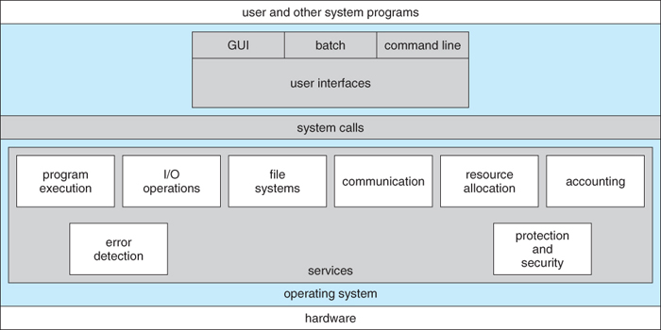
Operating System Overview
User Application Software
PC Hardware

Slide 3
Operating System Overview
0
User Application Software
PC Hardware

Slide 4
The main purpose of an Operating System
Simpler / More Efficient Application Programs
Operating System handles the Computer Hardware
Operating System handles resource allocation
Consistent User Experience
Operating System provides a standard User Interface (Windows)
Operating System provides a standard way to store and browse data files and folders (File Explorer)
Allow Multiple Applications Running At Same Time
Operating System Provides Ownership Control (User Accounts)
Operating System Schedules the CPU (Task Sharing)

Slide 5
Difference between Operating System Software and User Application Software
Hardware Independence
Same applications can run on different computer hardware
Operating System must be configured according to hardware components present in the computer
User Interface
Applications focus on what is contained and displayed within a window
Operating System controls opening / closing / resizing windows and responding to mouse and keyboard actions
Operating System provides standard ways to print, save and open files, access the internet, etc.
Resource Allocation
Applications just ask for what they need (e.g. Memory, Disk Space)
Operating System checks for availability and access permission
Operating System coordinates resource allocation between applications

Slide 6
The main parts of an Operating System
Graphical User Interface (GUI)
Manages Windows Display, mouse, keyboard, sound, etc. and provides feedback to user application programs through system calls.
System Calls
Allows user application programs to access Operating System resources
Allows Operating System to provide feedback to user programs
Device Drivers
Converts a basic function (e.g. Display a Pixel) to detailed commands for a specific make and model of hardware (e.g. Nvidia GeForce RTX 2070)
I/O Manager
Schedules access to input / output devices (e.g. disk drive) to avoid conflicts between user applications

Slide 7
The main parts of an Operating System
Memory Manager
Allocates separate regions of RAM memory to running user applications enforces security between the regions
Process Manager
Schedules different applications to run for short periods of time and cycles between applications to keep them all running (Lag or slow program execution is an indication of process scheduling problems.)
Security Monitor
Manages and enforces privileges and access to hardware devices and resources
Manages and enforces ownership and access privileges to user accounts and user files.
Update Manager
Runs a periodic audit to make sure all software components and device drivers are up to date.
Important part of virus protection and system security

Slide 8
Some popular operating systems
Windows OS
PCs / Laptops / Tablets
Mac OS
PCs / Laptops
Linux / Unix
PCs / Laptops / Phones / Embedded Devices
Android / Chrome
Phones / Tablets / Embedded Devices
iOS
Phones / Tablets
z/OS
IBM Mainframe Computers

Slide 9
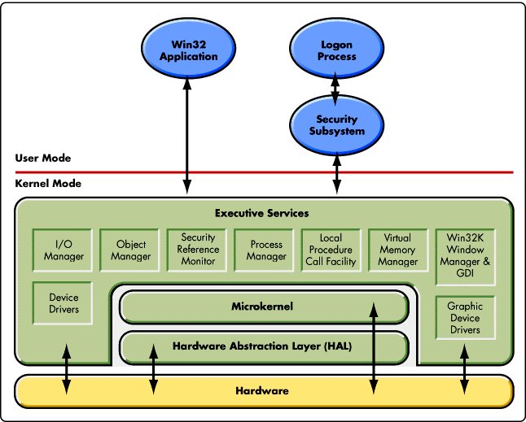
Reference Diagram (Student Questions)

